Slide 1

The Effects of Vaping
By: Miles A. Peña
Bellevue University
DSC 500 Introduction to Data Science
Matthew Metzger
October 24, 2023

Slide 2

The Big Smoking Debate
Smoking was done everywhere and by mostly everyone it seemed, as the media portrayed smoking as a statement.
Marketing and advertising in the 30s, 40s, and 50s even included health claims such as being gentle on one’s throat or even that they could aid digestion.
It wasn’t until nearly the mid 60s that people started to become informed on the effects on one’s health that accompanied smoking due to the Surgeon General’s report.

Slide 3

The Introduction of the E-Cigarette
Electronic cigarettes entered the market in about 2007 and many have switched over to these with many others taking up e-smoking since it was deemed safer than smoking.
But are vapes actually effective in helping smokers quit or are they more likely to entice non-smokers to take up vaping due to it not being as risky to one’s health?

Slide 4
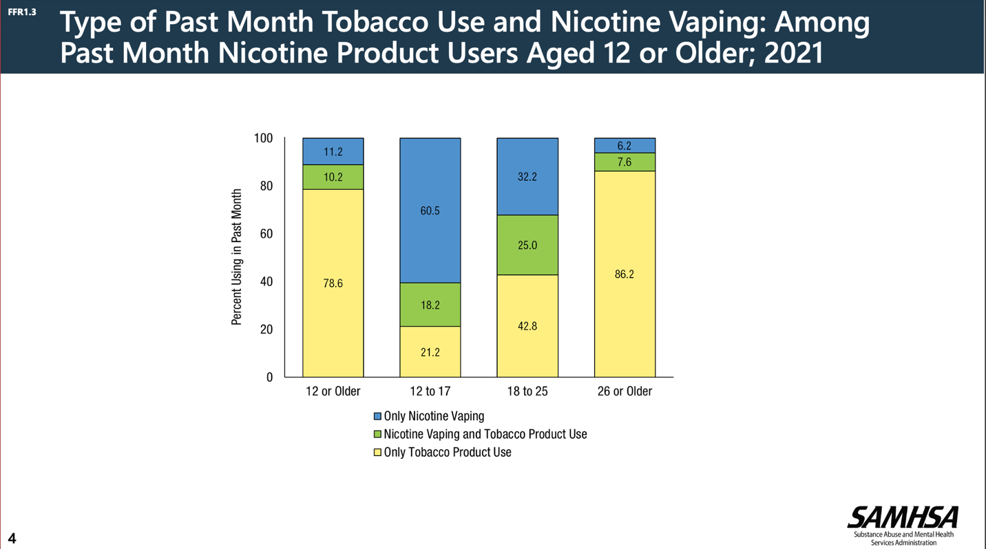
Tobacco Use vs. Nicotine Vaping
It is now more common for individuals to vape nicotine than smoke cigarettes.
In 2021, “among people aged 12 and older, 15.6% (or about 43.6 million people) reported smoking cigarettes in the past 30 days and 4.7% (or about 13.2 million people) reported vaping nicotine in the past 30 days” (Tobacco, Nicotine, and E-Cigarettes Research Report, 2022).
As shown by the statistics and the graph, the introduction of vapes into the market leads to the potential addiction of the younger generations.

Slide 5
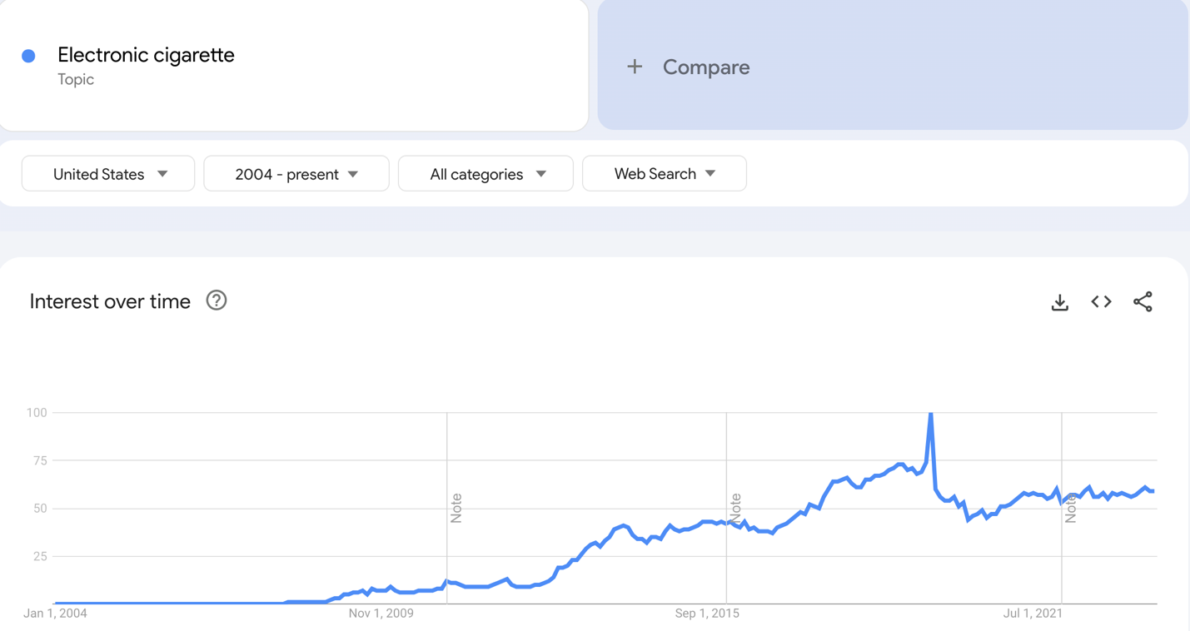
The Gradual Increase in Vaping Popularity
Vaping is still not considered safe to do.
“There has been an outbreak of lung injuries and deaths associated with vaping. In February 2020, the Centers for Disease Control and Prevention (CDC) confirmed 2,807 cases of e-cigarette or vaping use-associated lung injury (EVALI) and 68 deaths attributed to that condition” (Blaha, n.d.).
The popularity of vaping continues to gradually increase as time progresses as shown by the Google Trends graph.

Slide 6

For Better or For Worse…?
Unfortunately, there still doesn’t seem to be a consensus of whether or not vaping assists with quitting conventional smoking.
It is possible that it’s doing the opposite and enticing more and more individuals from younger generations to take up smoking when they otherwise wouldn’t have done it.

Slide 7

Vaping as a Means to Quit Smoking
A study conducted by the University of California San Diego claims that “a recent PATH Study analysis found that those who switched to e-cigarettes between 2014 and 2016 were more likely to relapse to cigarette smoking by 2017 than those who were free from all tobacco including e-cigarettes between 2014 and 2016” (Chen et al., 2017-2019)
This points to the direction that at least throughout those years, vaping was not a successful replacement for those wanting to quit smoking.

Slide 8
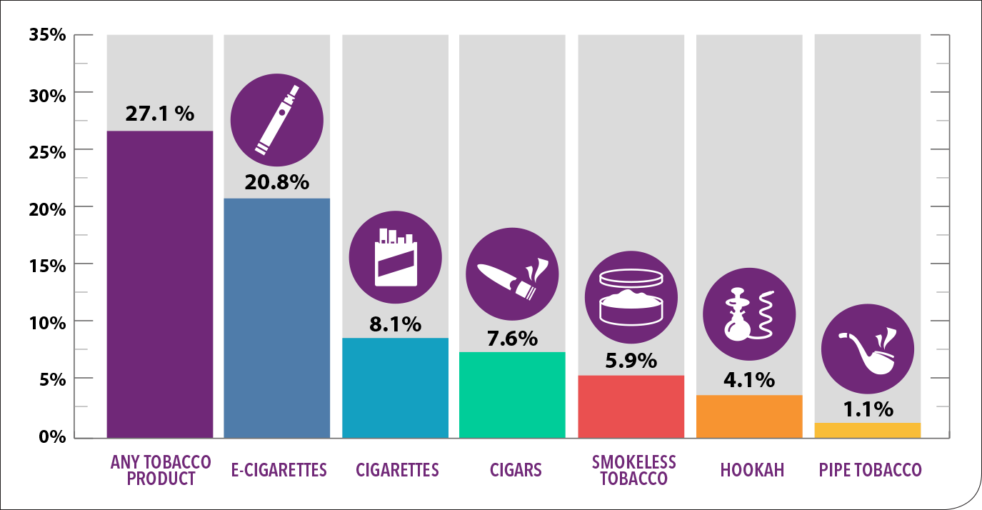
Teens and Vaping
Another study shows that “teenagers who used e-cigarettes for 30 days were twice more likely to start conventional cigarette smoking” (Alotaybi et al., 2022) and that “the use of e-cigarettes in the last 30 days increased 10-fold from 1.5% in 2011 to 16% in 2015 among high school students in the United States, exceeding the prevalence of traditional cigarette smoking (9.3%)” (Alotaybi et al., 2022).

Slide 9

The Dangers of Vaping
While there is not much evidence proving or disproving the negative health impacts of vaping, there are preliminary studies that suggest that vaping does pose both health and safety issues.
“E-cigarette smoking was found to be associated with 2.1 times more obstructive lung function impairment, and computed tomography (CT) scans performed on e-cigarette smokers showed local inflammation with impaired gas exchange caused by aerosolized oils from e-cigarettes” (Alotaybi et al., 2022).
There have been many instances and reports where an individual has been injured physically in relation to vaping such as having the e-cigarette explode or self-combust.

Slide 10

Conclusion
Nicotine addiction is still very possible with vaping.
While vaping seems to be the “healthier” option of the two, there are still health risks associated with vaping and electronic cigarettes.
The reality is that vaping is drawing in the younger generation at a rapid rate and since it is still fairly new, we do not know all the effects that vaping might have on the body over prolonged periods of time.
It is important that we listen to medical research and professionals and take their warnings seriously instead of taking all the information from the media as people did with smoking decades ago.

Slide 11
References
Alotaybi M, Alzahrani SS, Algethmi AM, Alamri NS, Natto YS, Hashim ST, Altammar A, Alzubaidi AS, Alzahrani IB, Alghamdi AA. E-cigarettes and Vaping: A Smoking Cessation Method or Another Smoking Innovation? Cureus. 2022 Dec 12;14(12):e32435. doi: 10.7759/cureus.32435. PMID: 36644067; PMCID: PMC9833272.
Blaha, M. J. (n.d.). 5 Vaping Facts You Need to Know. Johns Hopkins Medicine. https://www.hopkinsmedicine.org/health/wellness-and-prevention/5-truths-you-need-to-know-about-vaping
Chen R, Pierce JP, Leas EC, et alEffectiveness of e-cigarettes as aids for smoking cessation: evidence from the PATH Study cohort, 2017–2019Tobacco Control 2023;32:e145-e152.
Cummings, K., & Proctor, R. N. (2014, January 12). The Changing Public Image of Smoking in the United States: 1964–2014. National Library of Medicine. https://www.ncbi.nlm.nih.gov/pmc/articles/PMC3894634/#:~:text=In%20the%201960s%20and%20even,planes%20(1%2C%204).
Doctrow, B. (2022, January 25). E-cigarette use may lead some to quit traditional cigarettes. National Institutes of Health. https://www.nih.gov/news-events/nih-research-matters/e-cigarette-use-may-lead-some-quit-traditional-cigarettes
Electronic cigarette. (n.d.). Google Trends. Retrieved September 17, 2023, from https://trends.google.com/trends/explore?date=all&geo=US&q=%2Fm%2F02vlckk
2021 NSDUH Annual National Report. (2023, January 4). Substance Abuse and Mental Health Services Administration. https://www.samhsa.gov/data/report/2021-nsduh-annual-national-report

